Slide 1
The Nippon Foundation – GEBCO
SEABED 2030
100% of the Ocean Floor Mapped by 2030

Slide 2
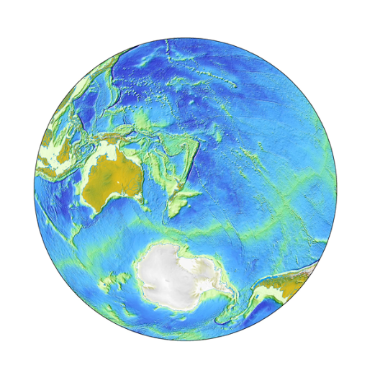
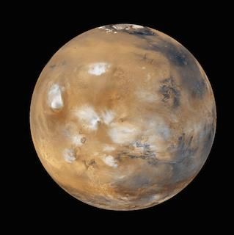
Notes:
“We’ve mapped Mars, the moon and other planets to a higher resolution … than we have mapped our ocean beds.”
Our understanding of the ocean and natural processes occurring at the seafloor is therefore quite limited due to the difficulties in operating in this environment. This has left the vast majority of our planet virtually unmapped, unobserved, and unexplored.
Our challenge – ‘Why don’t we know more?’ As this group knows solutions for the water are well and truly here, it is the effort and the funding…… and at times geopolitics…
Interestingly the funding of 1 Mars mission of US$3B would map 90% of the seafloor of our oceans.
- it is about time that we had better maps for the seventy percent of planet earth that is covered in water.

Slide 3
Seabed 2030 Mission
100% of the Ocean Floor Mapped by 2030
To empower the world to make policy decisions, use the ocean sustainably and undertake scientific research based on detailed bathymetric information of the Earth’s seabed
Supports United Nations Sustainable Development Goal 14:
to conserve and sustainably use the world’s oceans, seas and marine resources
Notes:
Objectif de développement durable n°14 : vie aquatique - Conserver et exploiter de manière durable les océans, les mers et les ressources marines aux fins du développement durable.

Slide 4
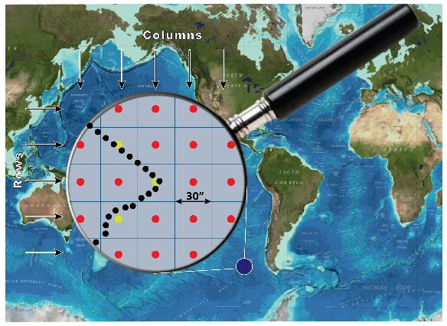
The GEBCO global terrain model grid
What does “100% mapped” mean?
ship-track soundings + interpolation guided by satellite-derived gravity data
Includes regional grids which may be based on different interpolation models
18% of 30” cells have depth measurements
6% of 15” cells have depth measurements
Real depth measurements
Interpolated depth values
Depth values derived from statistics of real depth values.
Notes:
NF focuses on social innovation
“Forum for the Future of Ocean Floor Mapping” in Monaco in June of 2016.
Launched in 2017 at the UN Ocean conference in NY
Project begin in Feb 2018

Slide 5
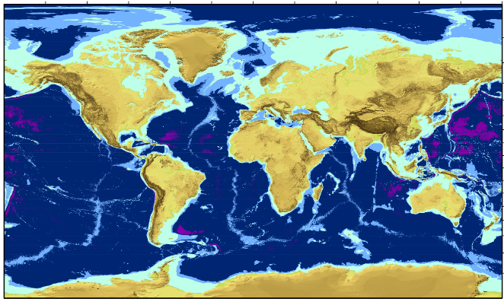
Target Grid Variable Resolution
Target GEBCO Grid
Depth-dependent Variable Resolution
Depth Range | Resolution | % of ocean
0–1500 m | 100 × 100 m | 13.7
1500–3000 m | 200 × 200 m | 11
3000–5750 m | 400 × 400 m | 72.6
5750–11,000 m | 800 × 800 m | 2.7
Notes:
0-1500m: Mainly within EEZs. Strategy to work with hydrographic offices to provide data. Crowd source data from fishing, transport industry and recreational boating in shallower areas. Industry and scientific expedition will also provide data. .
1500-3000m: partly within EEZs. Crowd source from single beam will not play a major role due to resolution and less activity in deeper waters. Industry & scientific community will play critical role. Map the gaps activities focus on AREA.
300-5750m: mainly outside of EEZs. Industry & scientific community will play a major role and crowd source from single beam a minor. Map the gaps activities
5750-11000m: Mostly outside of EEZs. Industry and scientific community will play a major role and crowd source from single beam a minor. Map the gaps activities

Slide 6
Four Pillars of Seabed 2030
Data Assembly and Coordination
Integrate and process existing data & identify data gaps to inform future mapping missions
Promote data sharing by encouraging contribution of data to the IHO DCDB
Create new data products – distribute through GEBCO
Global Community Engagement
Identify & engage stakeholders through community events, traditional & digital media
Consolidate Technical and Human Capacity
Explore and leverage new technology
Engage GEBCO Nippon Foundation Training Project Alumni
Cross-cutting area of Corporate Governance
Strong stakeholder communication
Legal and accounting standards

Slide 7
Working plan
WP 1: Gathering, synthesizing, publishing bathymetric data
Merging all available data into the high resolution ocean map
WP 2: Development of standards, data assembly and delivery tools
Developing the tools and systems to facilitate building and using the map.
WP 3: Technology innovation
Identifying and encouraging technical innovation in bathymetric mapping
WP 4: Networking: map the gaps
Future mapping expeditions to increase the coverage
WP 5: Management
Managing the project

Slide 8
Seabed 2030 Culture
Co-operation and Community Building
3,000 individuals, 40 organizations, 50 countries and growing
Coordination
Initial Seabed 2030 focus on > 200 meters water depth
Hydrographic Offices critical < 200 meters water depth
Crowdsourcing
Fishing boats, cargo, passenger and cruise ships, private yachts…
Credit and Attribution
Recognize data contributions, in-kind services, promotion, capacity building…
https://seabed2030.gebco.net
@seabed2030

Slide 9
Seabed 2030 Governance & Operations
Review Panel
GEBCO Guiding
Committee
SCRUM
SCUFN
TSCOM
Advisory
Group
Project Team
Director + Center leads
N Pacific & Arctic Ocean
Atlantic & Indian Ocean
Global
Center
Southern Ocean
South & West Pacific

Slide 10
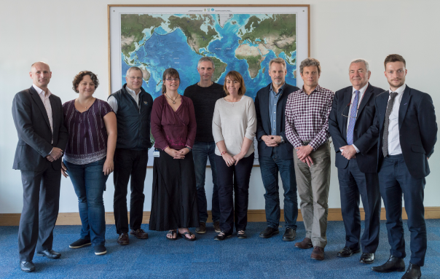
Seabed 2030 Governance & Operations
Leader Team
Illustration: Marine Dep. Malaysia
Operational since1st February 2018
From left to right:
Graham Allen (Establishment Team)
Vicki Ferrini (Regional Centre Lead)
Larry Mayer (Regional Center co-Lead)
Helen Snaith (Global Center Lead)
Boris Dorschel (Regional Center Lead)
Pauline Weatherall (Digital Atlas Manager)
Martin Jakobsson (Regional Center co-Lead)
Geoffroy Lamarche (Regional Center Lead)
Patrick Orr (Comms)
Henry Gilliver (Comms)
New mapping technologies
Notes:
222 days old

Slide 11
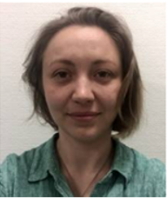
Seabed 2030 Governance & Operations
Strategic Advisroy Group
Advisory
Group
Dawn Wright
Chief Scientist, ESRI
Bjorn Jalving
Executive VP, Konsberg Maritime
Dr. Kilaparti Ramakrishna
Head of Strategy, Green Climate Fund
Yulia Zarayskaya
NF-GEBCO Alumni Team Lead XPrize

Slide 12
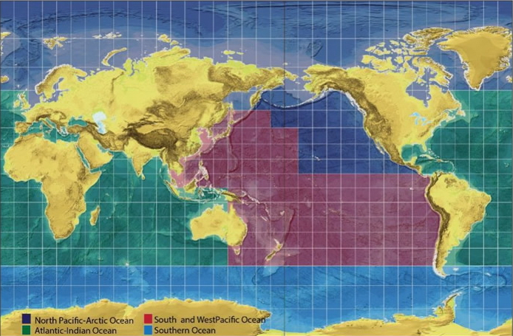
Regional Approach
Regional stakeholders
Regional data assembly & coordination
Regional products feed into global GEBCO products
Follows successful model of GEBCO Regional Mapping approach
SU
AWI
UNH
BODC
LDEO
NIWA-GNS-LINZ

Slide 13
Data Sources
Break down of the source of data types that the GEBCO grid is based on
Grid cell type (30 arc-second) | GEBCO_2014 | New grid
Interpolation guided by satellite-derived gravity data | 66.5% | 62.4%
Interpolation guided by computer programme, e.g. GMT | 14% | 14.3%
Multibeam | 9% | 12.4%
Single beam | 1.9% | 1.8%
Pre-generated grid | 2.7% | 4.3%
Unidentified track type | 3.9% | 2.8%
Isolated soundings, e.g. ENC soundings | 0.1% | 0.1%
Contours | 1.9% | 1.9%

